Slide 1
Application Security Verification Standard 4.0
Andrew van der Stock, co-leader ASVS Project
March 2019 - NullCon

Slide 2

Andrew van der Stock
Senior Principal Consultant, Synopsys
Technical Leader of Managed Services
Joined OWASP late ~2002
Lifetime OWASP member
Board Member (2015-2018) and Treasurer (2016-2018)
Selected works:
Application Security Verification Standard
OWASP Top 10 {2007, 2017}
OWASP Developer Guide 2.0

Slide 3
What is the ASVS?
Started as 80/20 checklist
Designed to be an actual application security standard
Set of leading practices – even 2.0 was challenging for many
Community and Industry Driven
Completely developed in the open at GitHub
Submit issues! Submit PRs! Translate please!

Slide 4
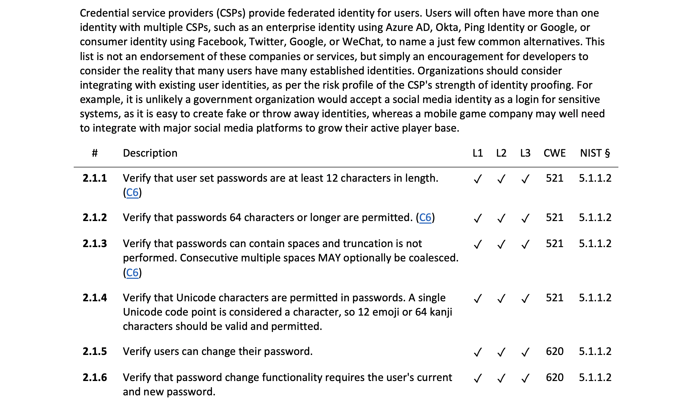

Slide 5
Who is involved?
You
Andrew van der Stock, Daniel Cuthbert, Jim Manico
Josh Grossman, Mark Burnett, Abhay Bhargarv
Amazing reviewers such as Elar Lang, ossie-git, Ron Perris, Tonimir Kisasondi, Serg Belokamen, Jason Axley, and Adam Caudill

Slide 6
So what’s new?

Slide 7
What’s new
Now completely written in Markdown
Uses MASVS script and CSV generation
Easy to translate
Easy to determine what changed, when, by whom, and why
NIST 800-63 compliance
IoT ASVS Preview Chapter

Slide 8
Modern web applications
Full support for server-less, responsive applications
Containers
API
DOM
Templating

Slide 9
CWE all the things
Most requested feature for the last decade finally delivered
Let’s talk about CWE for a minute
ASVS is a control based standard
Weaknesses are not controls
CWE is an imperfect mapping, but it’s the mapping we have
Not every item ended up with a CWE. CWE needs our help

Slide 10
What’s changed
Basically everything
Renumbered completely
Each section is reorganized and re-ordered
De-duped. Do not omit any section for your level

Slide 11
L1 is the new minimum
OWASP Top 10 2017 is simply not sufficient
Level 1 is now completely testable using pentest techniques
It’s the only level that is completely penetration testable
Stop penetration testing. Hybrid reviews at least!

Slide 12
PCI DSS 6.5.x
Yep
We even included buffer overflows, integer and safer string operations, as well as ensuring that folks compiled code properly!

Slide 13
What’s gone
Less impactful controls
Controls that were implemented by one browser or language
“Since”
Mobile Chapter (use MASVS)
IoT Chapter (use IoT Project)

Slide 14
Detailed Changes

Slide 15
V1 Architecture
Completely revamped
Replaces “dead” section with something that can produce secure by default software
Requires Secure Software Development Lifecycle
Requires threat modeling
Design and build security in!
Levels 2 and 3 only

Slide 16
V2 Authentication
Aligned with NIST 800-63
Except that we had to go to 12 characters for SFA passwords
Credential lifecycle from issuance to retirement
Credentials construction and protection, including credential stuffing
Credential recovery
Credential storage requirements
Multi-factor now covers soft tokens through crypto signing calculators
FIDO support

Slide 17
V3 Session Management
Deals with APIs, JWT, token, API, and cookie based session management
Longer timeouts for many apps for refresh tokens
Federated session management including full logout
Half open attack!

Slide 18
V4 Access Control
Covers API access control security
Covers serverless and cloud access control (”server-side” is gone)

Slide 19
V5 Validation, Sanitization, and Encoding
Major revamp
Divided into easy to consume sections
Standardized Input and Output Pipelines
Input validation for modern applications and APIs
Output encoding is the new hotness
Injection prevention (including XXE and XML attacks)
SSRF
Deserialization

Slide 20
V6 Stored Cryptography
Data classification – only encrypt the things you need
Algorithm agility
Random values
Secret management (i.e. HSMs, TPMs, OS key stores)

Slide 21
V7 Error handling
It’s about reducing the time to detect breaches
Don’t log everything, make it easy to detect breaches
Log protection
User friendly error handling improvements

Slide 22
V8 Data Protection
Protecting the most important data assets
Sensitive Private Data Protection
Covers many technical requirements for GDPR and other privacy laws
Client side protection (HTML 5 local storage etc)

Slide 23
V9 Communications Security
Now DevSecOps friendly
No more building a secure chain / path … what does that even mean?
Easier to comply … automatically
TLS all the things
Use modern configuration builders
Use the verification tools you use today

Slide 24
V10 Malicious Code
Major update to this section to cover more than just time bombs and Easter eggs
Detect malicious code introduction
Continuous detection through building
Privacy invading libraries (Google’s PUA) mentioned for first time
Malicious business logic, such as salami attacks
Privacy invading permissions (camera, location, microphone, contacts, etc)
Mostly Level 3 for apps that can kill you or run the world economy

Slide 25
V11 Business Logic Verification
Major update
Business logic step order
Business logic human time
Business logic limits
Business logic anti-automation
Threat model (attack driven design) business logic risks
TOCTOU Race conditions that might affect business logic
Monitoring, alerting, and detection of unusual business logic events

Slide 26
V12 Files and Resources
Major revamp
Architecture items moved to architecture
Configuration items moved to configuration
Upload - Size and number
Contents and integrity
Storage, including malicious file detection
Execution, including LFI, RFI, and SSRF
Download

Slide 27
V13 API Security
Total revamp
General controls include common sense API controls
Must be read in conjunction with authentication, authorization and session management
RESTful includes schema validation, CORS and origin attacks
SOAP – fewer more impactful items, far clearer, and not obfuscated
GraphQL and Web Service Data Layer

Slide 28
V14 Configuration
Major revamp
Repeatable, Continuous integration, continuous deployment
Support for DevSecOps culture and agile practices
Containers
Dependency checks mandated
Sandboxing components including uploaded assets
Sub-domain takeover

Slide 29
I’m in. How do I use it?

Slide 30
Generally Accepted Security Practices
Secure code review
Security architecture
Integration testing
Peer coding checklists
Developer training
Unit testing
Hybrid reviews
DevSecOps automation
Vulnerability programs
Consultant training
Tool Benchmark
Secure coding checklist
Penetration test
Deployment checklist
Functional constraints
Planning Sprint Assistance
Non-functional and functional features
Supplier Benchmarking

Slide 31
How do I use it?
Use it as is or fork it
Level 1 – entry level, penetration testing
Level 2 – most apps
Level 3 – apps that can kill you or run the world economy
Deep standards have no bounds

Slide 32
How to get involved
Grab a copy today and start to migrate from earlier versions and T10
We need translations. Please join the #asvs channel on OWASP Slack
We need case studies! If you use ASVS, we’d love to hear from you!
Create issues or pull requests if you identify issues

Slide 33
When can I get it?
The ASVS 4.0 Final is available now!
OWASP Wiki – Word, PDFs, CSVs, and Hot Linkable markdown
GitHub - Final Version is in the 4.0 branch
GitHub – Development Version is in the master branch
You can also get this presentation so you can give this to your local chapter, school, college, or workplace!

Slide 34
Thank you
vanderaj@owasp.org (ASVS) | vander@synopsys.com ($dayjob)
@vanderaj

